Slide 1
Chapter 4 Hierarchical Modeling
Dr. Nilesh Patil

Slide 2
Introduction
Bayesian hierarchical modeling is a statistical model written in multiple levels (hierarchical form) that estimates the parameters of the posterior distribution using the Bayesian method.
The sub-models combine to form the hierarchical model, and Bayes' theorem is used to integrate them with the observed data and account for all the uncertainty that is present.
The result of this integration is the posterior distribution, also known as the updated probability estimate, as additional evidence on the prior distribution is acquired.

Slide 3
Examples of Hierarchical Model
In epidemiological modeling to describe infection trajectories for multiple countries, observational units are countries, and each country has its own temporal profile of daily infected cases.
In decline curve analysis to describe oil or gas production decline curve for multiple wells, observational units are oil or gas wells in a reservoir region, and each well has each own temporal profile of oil or gas production rates (usually, barrels per month).

Slide 4

Posterior Distribution
Suppose a model family has parameters θ, which determine a probability distribution over outcomes, and a set of observations y arises as a collection of independent trials from this distribution.
Using the basic property of conditional probability, the posterior distribution will yield:
This equation, showing the relationship between the conditional probability and the individual events, is known as Bayes' theorem.

Slide 5
Exchangeability
Exchangeability in statistics refers to the assumption that the order of observations does not affect the statistical analysis.
In statistical analysis, we assume that the n values y₁, y₂, …, y_{n} are exchangeable.
If no information – other than data y – is available to distinguish any of the θ_{j}’s, from any others, and no ordering or grouping of the parameters can be made, one must assume symmetry among the parameters in their prior distribution.
This symmetry is represented probabilistically by exchangeability.
Generally, it is useful and appropriate to model data from an exchangeable distribution as independently and identically distributed, given some unknown parameter vector θ, with distribution P(θ).
Types:
Finite Exchangeability
Infinite Exchangeability

Slide 6


Finite Exchangeability
For a fixed number n, the set y₁, y₂, …, y_{n} is exchangeable if the joint probability P(y₁, y₂, …, y_{n}) is invariant under permutations of the indices. That is, for every permutation π or (π₁, π₂, …, π_{n}) of 1, 2, …, n, P(y₁, y₂, …, y_{n}) = P(y_{π1}, y_{π2}, …, y _{πn}).
Example: Consider an urn with a red ball and a blue ball inside, with a probability 0.5 of drawing either. Balls are drawn without replacement, i.e., after one ball is drawn from the n balls, there will be (n-1) balls remaining for the next draw.
Since the probability of selecting a red ball in the first draw and a blue ball in the second draw is equal to the probability of selecting a blue ball on the first draw and a red on the second draw, both of which are equal to 0.5, i.e.
y₁, and y₂ are exchangeable.

Slide 7
Infinite exchangeability
Infinite exchangeability is the property that every finite subset of an infinite sequence y₁, y₂, ….. is exchangeable.
That is, for any n, the sequence y₁, y₂, …, y_{n} is exchangeable.

Slide 8
Components of Hierarchical Model
Bayesian hierarchical modeling makes use of two important concepts in deriving the posterior distribution, namely:
Hyperparameters: parameters of the prior distribution
Hyperpriors: distributions of Hyperparameters
Suppose a random variable Y follows a normal distribution with parameter θ as the mean and 1 as the variance, i.e. Y| θ ~N(θ,1).
Suppose also that the parameter θ has a distribution given by a normal distribution with mean μ and variance 1, i.e. θ| μ ~ N(μ,1).
Furthermore, μ follows another distribution given, for example, by the standard normal distribution, N(0,1).
The parameter μ is called the hyperparameter, while its distribution given by N(0,1) is an example of a hyperprior distribution.

Slide 9
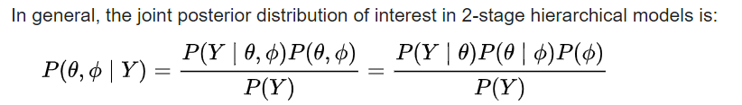

2-stage hierarchical model

Slide 10
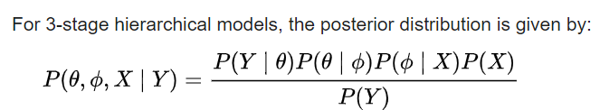
3-stage hierarchical model

Slide 11
Bayesian Sensitivity Analysis
Bayesian sensitivity analysis is a statistical technique used to assess the impact of uncertainty in model parameters on the outcomes of a Bayesian statistical model.
It's a way to quantify how changes in input parameters affect the results of a Bayesian analysis, particularly in the context of Bayesian inference and probabilistic modeling.
In Bayesian sensitivity analysis, you typically start with a prior distribution for your model parameters, representing your initial beliefs about their values. Then, you update this prior distribution with observed data using Bayes' theorem to obtain a posterior distribution.
The sensitivity analysis comes into play when you examine how varying the prior distribution or other aspects of the model influences the posterior distribution and, consequently, your conclusions.

Slide 12
Methods for Bayesian Sensitivity Analysis
Sensitivity analysis in Bayesian modeling can be conducted through various methods, including:
Posterior Predictive Checks: By simulating data from the posterior distribution and comparing it to the observed data, you can assess how well your model accounts for uncertainty.
Varying Prior Distributions: Changing the prior distribution or its parameters can help you understand how your conclusions might change with different assumptions.
Threshold and Credible Intervals: Examining how credible intervals change as you vary model parameters can provide insight into sensitivity.
Sensitivity to Data: Assessing how the model responds to different subsets of the data or changes in data quality.
Monte Carlo Markov Chain (MCMC) Diagnostics: MCMC methods used in Bayesian analysis can provide diagnostics like trace plots, Gelman-Rubin statistics, or effective sample size to assess convergence and sensitivity.

Slide 13
Applications of Bayesian Sensitivity Analysis
Monte Carlo Simulation: Perform a Bayesian sensitivity analysis on a financial model to assess the impact of varying input parameters on the net present value.
Drug Efficacy: Use Bayesian sensitivity analysis to evaluate how uncertainty in prior beliefs affects the posterior distribution of a new drug's effectiveness.
Environmental Risk: Conduct a Bayesian sensitivity analysis to determine the sensitivity of ecological risk assessments to variations in input data for a proposed construction project.
Supply Chain Optimization: Apply Bayesian sensitivity analysis to a supply chain model to understand how changes in demand forecasts and lead times affect inventory levels and costs.
Portfolio Optimization: Use Bayesian sensitivity analysis to investigate how different assumptions about asset return distributions impact the allocation of investments in a portfolio.

Slide 14
Model Comparison
In Bayesian statistics, model comparison involves evaluating the relative performance of different statistical models in explaining observed data.
This is typically done by comparing the posterior probabilities of these models given the data.
Here are some key points about model comparison in Bayesian statistics:
Baye’s Theorem
Baye’s Factor
Model selection Criteria
Model Averaging
Prior Sensitivity
Computational Methods

Slide 15
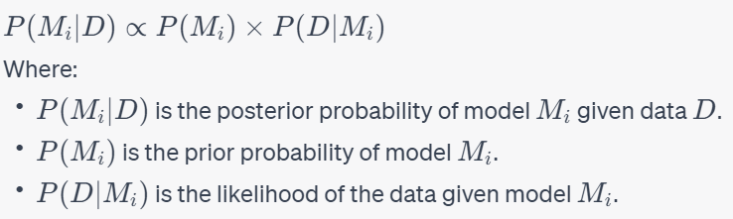
Baye’s Theorem
Model comparison in Bayesian statistics relies on Bayes' theorem, which relates the posterior probability of a model (given the data) to the prior probability of the model and the likelihood of the data given the model. Mathematically, it can be expressed as:

Slide 16

Baye’s Factor
The Bayes factor is a common measure used for model comparison.
It quantifies the relative support in the data for one model over another.
It can be calculated as the ratio of the marginal likelihoods of the two models:
A Bayes factor greater than 1 indicates that model M_{i}​ is more supported by the data compared to model M_{j}​.

Slide 17
Model Selection Criteria
Bayesian model comparison often involves comparing different models based on information criteria like the Bayesian Information Criterion (BIC) and the Deviance Information Criterion (DIC).
These criteria balance the goodness of fit and model complexity, providing a quantitative way to assess which model is more suitable for the data.

Slide 18
Model Averaging
Instead of selecting a single model, Bayesian model comparison can also involve model averaging.
This means combining information from multiple models based on their posterior probabilities to make predictions or inference.

Slide 19
Prior Sensitivity
The choice of prior distributions for model parameters can impact model comparison results.
Sensitivity analysis, which involves assessing how different priors influence the outcomes, is a crucial aspect of Bayesian model comparison.

Slide 20
Computational Methods
Bayesian model comparison often requires complex calculations, especially for estimating marginal likelihoods.
Markov Chain Monte Carlo (MCMC) and other Bayesian computational techniques are commonly used to perform these calculations.

Slide 21
Comparison of Hypotheses
Hypotheses are statements or educated guesses that researchers make before conducting experiments or studies.
Comparing hypotheses typically involves evaluating their similarities and differences.
Here are some examples to help you understand how hypotheses can be compared:
Null vs. Alternative Hypothesis:
Null Hypothesis (H0): There is no significant difference between Group A and Group B in terms of their test scores.
Alternative Hypothesis (H1): There is a significant difference between Group A and Group B in terms of their test scores.
This is a common comparison in statistical hypothesis testing.
Directional vs. Non-Directional Hypotheses:
Directional Hypothesis: The new drug will improve patient recovery time compared to the current treatment.
Non-Directional Hypothesis: There will be a difference in patient recovery time between the new drug and the current treatment.
Directional hypotheses predict the direction of the effect (i.e., improvement or decline), while non-directional hypotheses only predict the presence of a difference.
3. Comparative Hypotheses:
Hypothesis 1: Male students will score higher on the math test than female students.
Hypothesis 2: Female students will score higher on the language arts test than male students.

Slide 22

Hypothesis Testing: Upper-, Lower, and Two Tailed Tests
Step 1. Set up hypotheses and select the level of significance α.
H₀: Null hypothesis (no change, no difference);
H₁: Research hypothesis (investigator's belief); α =0.05
Step 2. Select the appropriate test statistic.
The test statistic is a single number that summarizes the sample information.
An example of a test statistic is the Z statistic computed as follows:
When the sample size is small, we will use t statistics
Step 3. Set up decision rule.
The decision rule is a statement that tells under what circumstances to reject the null hypothesis. The decision rule is based on specific values of the test statistic (e.g., reject H0 if Z > 1.645). The decision rule for a specific test depends on 3 factors: the research or alternative hypothesis, the test statistic and the level of significance.
Step 4. Compute the test statistic.
Step 5. Conclusion.
The final conclusion will be either to reject the null hypothesis or not to reject the null hypothesis.

Slide 23
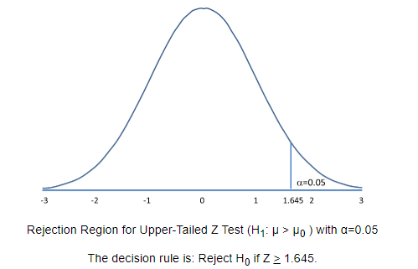
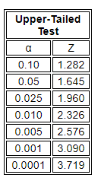
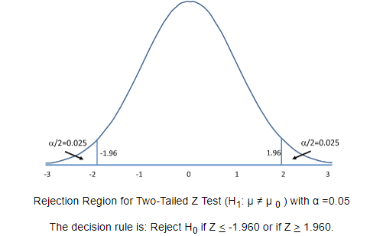
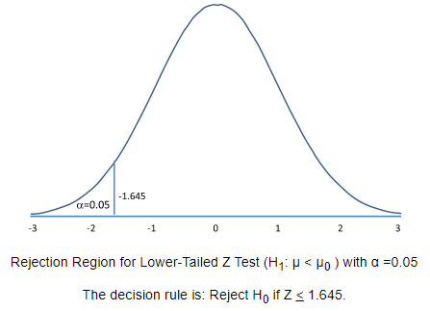
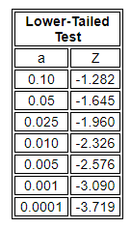
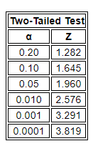

Slide 24
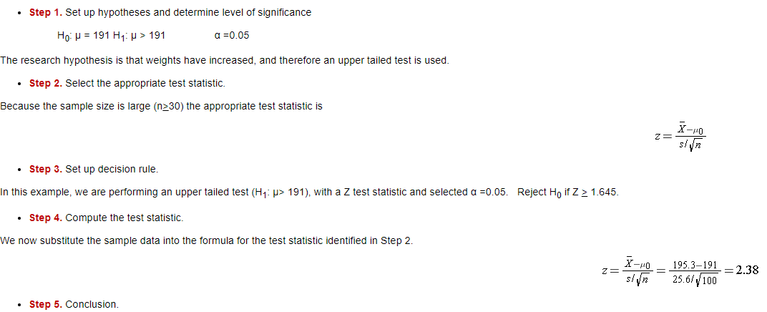
Example1 : Suppose that the mean weight in men in 2006 is more than 191 pounds.
We reject H₀ because 2.38 > 1.645.

Slide 25
Type I and Type II Errors
Do Not Reject H₀ | Reject H₀
H₀ is True | Correct Decision | Type I Error
H₀ is False | Type II Error | Correct Decision

Slide 26
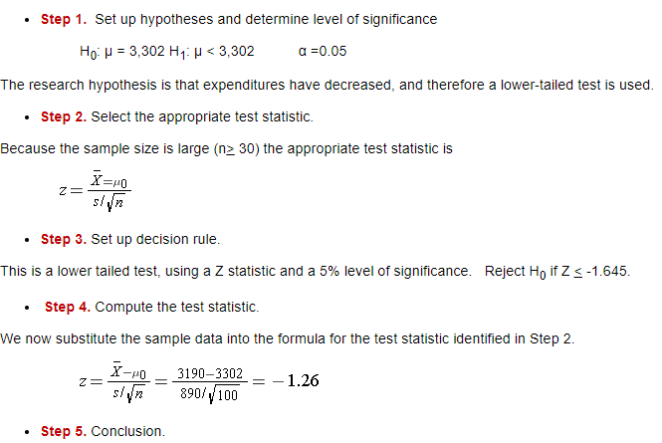
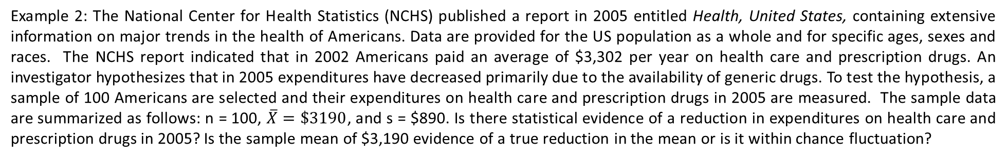
Example 2: The National Center for Health Statistics (NCHS) published a report in 2005 entitled Health, United States, containing extensive information on major trends in the health of Americans. Data are provided for the US population as a whole and for specific ages, sexes and races. The NCHS report indicated that in 2002 Americans paid an average of $3,302 per year on health care and prescription drugs. An investigator hypothesizes that in 2005 expenditures have decreased primarily due to the availability of generic drugs. To test the hypothesis, a sample of 100 Americans are selected and their expenditures on health care and prescription drugs in 2005 are measured. The sample data are summarized as follows: n = 100, $\overline{X}=\$3190$, and s = $890. Is there statistical evidence of a reduction in expenditures on health care and prescription drugs in 2005? Is the sample mean of $3,190 evidence of a true reduction in the mean or is it within chance fluctuation?
We do not reject H₀ because -1.26 > -1.645. We do not have statistically significant evidence at α=0.05 to show that the mean expenditures on health care and prescription drugs are lower in 2005 than the mean of $3,302 reported in 2002.

Slide 27
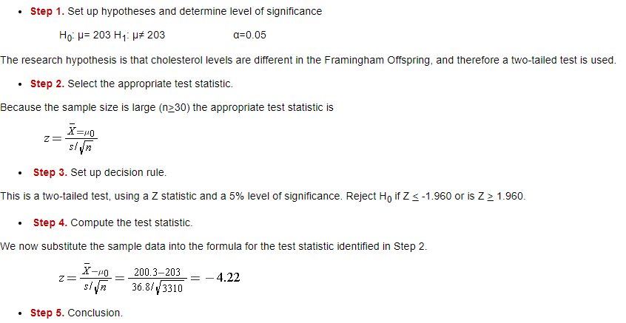
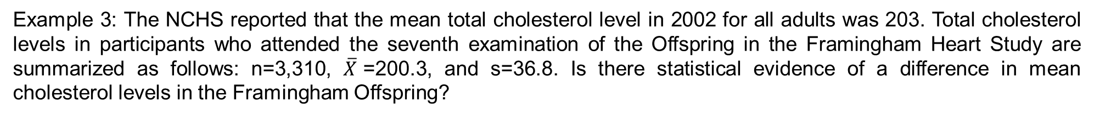
Example 3: The NCHS reported that the mean total cholesterol level in 2002 for all adults was 203. Total cholesterol levels in participants who attended the seventh examination of the Offspring in the Framingham Heart Study are summarized as follows: n=3,310, $\overline{X}$=200.3, and s=36.8. Is there statistical evidence of a difference in mean cholesterol levels in the Framingham Offspring?
Solution: Here we want to assess whether the sample mean of 200.3 in the Framingham sample is statistically significantly different from 203 (i.e., beyond what we would expect by chance).
We reject H₀ because -4.22 ≤ -1.960. We have statistically significant evidence at α=0.05 to show that the mean total cholesterol level in the Framingham Offspring is different from the national average of 203 reported in 2002.

Slide 28
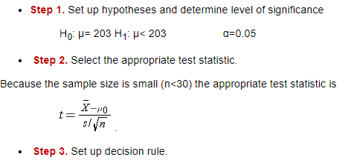
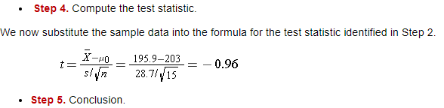
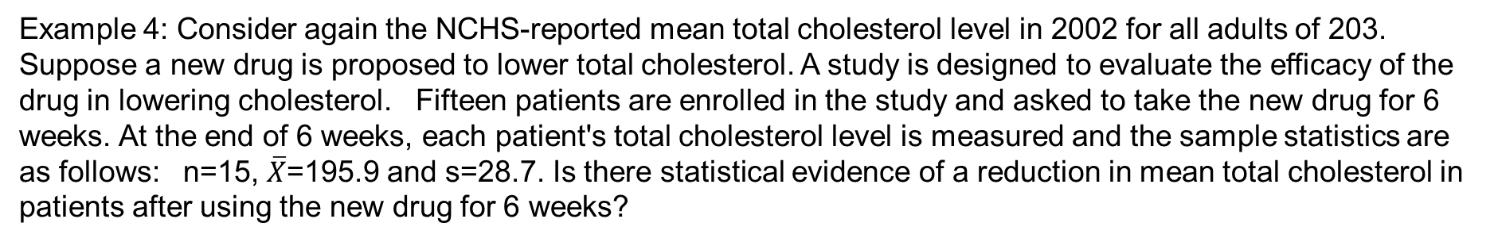
Example 4: Consider again the NCHS-reported mean total cholesterol level in 2002 for all adults of 203. Suppose a new drug is proposed to lower total cholesterol. A study is designed to evaluate the efficacy of the drug in lowering cholesterol. Fifteen patients are enrolled in the study and asked to take the new drug for 6 weeks. At the end of 6 weeks, each patient's total cholesterol level is measured and the sample statistics are as follows: n=15, $\overline{X}$=195.9 and s=28.7. Is there statistical evidence of a reduction in mean total cholesterol in patients after using the new drug for 6 weeks?
This is a lower tailed test, using a t statistic and a 5% level of significance. In order to determine the critical value of t, we need degrees of freedom, df, defined as df=n-1. In this example df=15-1=14. The critical value for a lower tailed test with df=14 and a =0.05 is -2.145 and the decision rule is as follows: Reject H₀ if t < -2.145.
We do not reject H₀ because -0.96 > -2.145. We do not have statistically significant evidence at α=0.05 to show that the mean total cholesterol level is lower than the national mean in patients taking the new drug for 6 weeks.

Slide 29
A Test of Independence in a Two-Way Contingency Table
The primary method for displaying the summarization of categorical variables is called a contingency table.
When we have two measurements on our subjects that are both categorical, the contingency table is sometimes referred to as a two-way table.
The size of a contingency table is defined by the number of rows times the number of columns associated with the levels of the two categorical variables. The size is notated r x c, where r is the number of rows of the table and c is the number of columns.
A cell displays the count for the intersection of a row and column. Thus, the size of a contingency table also gives the number of cells for that table.
For example, if we have a 2×2 table, then we have 2(2)=4 cells.

Slide 30
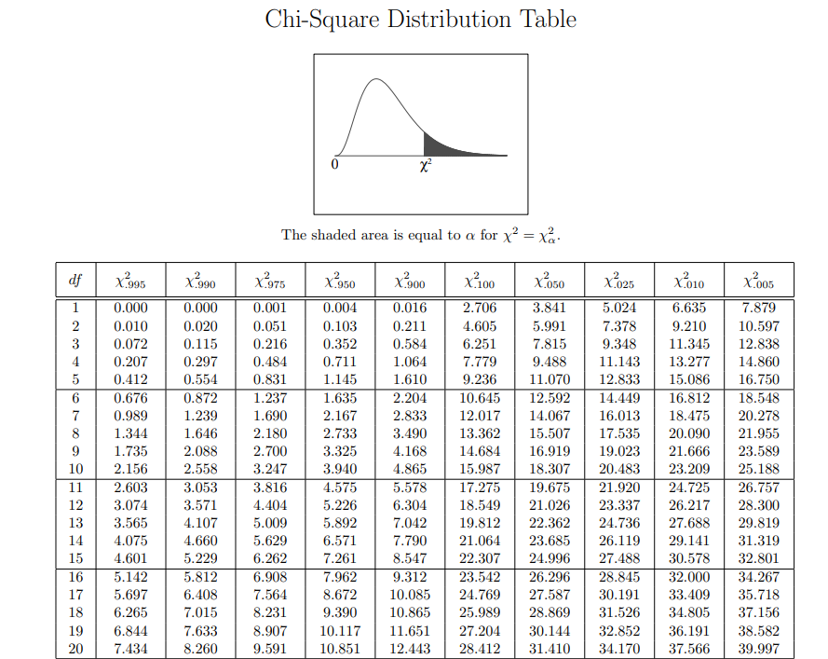

Slide 31
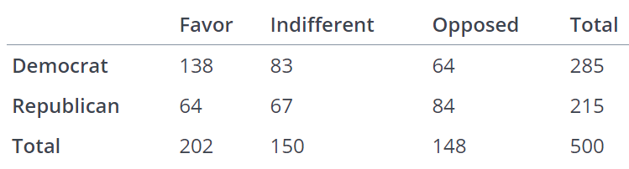
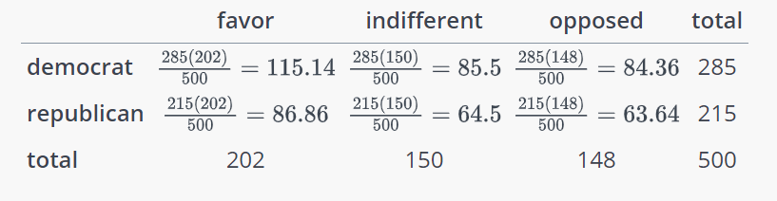
Example 1: A random sample of 500 U.S. adults is questioned regarding their political affiliation and opinion on a tax reform bill. The results of this survey are summarized in the following contingency table:
Test if the political affiliation and their opinion on a tax reform bill are dependent at a 5% level of significance using Chi-Square test.
Solution:
Step1:Find the expected counts for all of the cells.

Slide 32
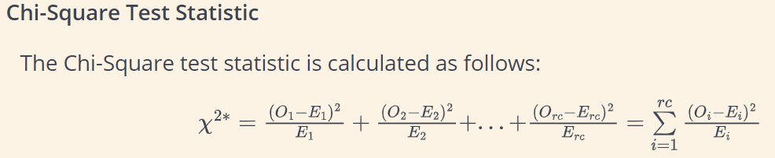
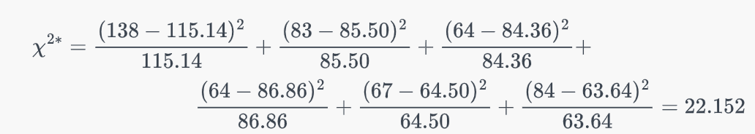
Step 2:
The test statistic follows a Chi-Square distribution with degrees of freedom equal to (r−1)(c−1),
Degrees for freedom equal to (2−1)(3−1)=2.
Step 3: At 5% level of significance and degree of freedom = 2, the critical value of chi-square = 5.991
Since the calculated chi-square value is greater than the critical chi-square value, we reject the null hypothesis that political affiliation and their opinion on a tax reform bill are independent. We conclude that there is evidence that the two variables are dependent (i.e., that there is an association between the two variables).

Slide 33
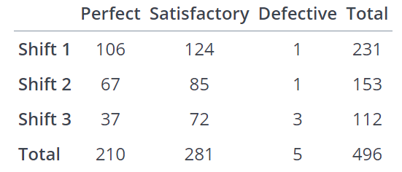
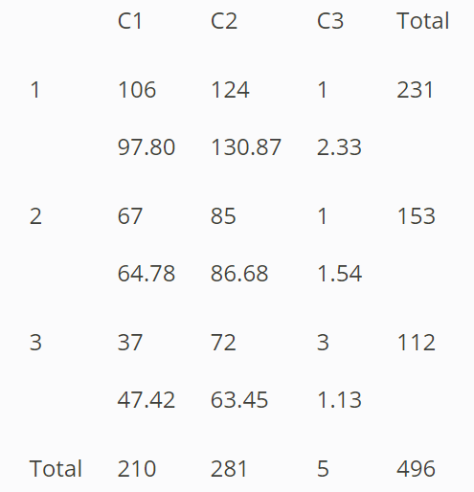
Example 2: The operations manager of a company that manufactures tires wants to determine whether there are any differences in the quality of work among the three daily shifts. She randomly selects 496 tires and carefully inspects them. Each tire is either classified as perfect, satisfactory, or defective, and the shift that produced it is also recorded. The two categorical variables of interest are the shift and condition of the tire produced. Does the data provide sufficient evidence at the 5% significance level to infer that there are differences in quality among the three shifts?
Expected
Solution:
Step1:Find the expected counts for all of the cells.
Expected
Expected

Slide 34
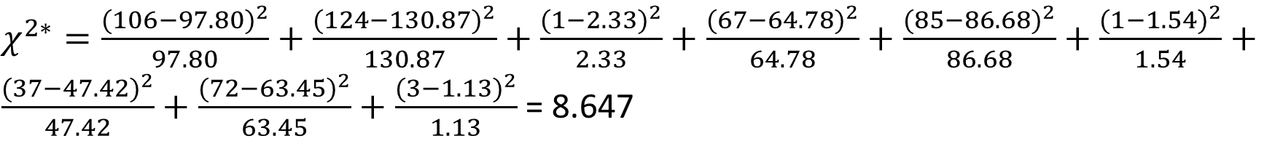
Step 2:
The test statistic follows a Chi-Square distribution with degrees of freedom equal to (r−1)(c−1),
$χ^{2∗}=\frac{{(106−97.80)}^{2}}{97.80}+\frac{{(124−130.87)}^{2}}{130.87}+\frac{{(1−2.33)}^{2}}{2.33}+\frac{{(67−64.78)}^{2}}{64.78}+\frac{{(85−86.68)}^{2}}{86.68}+\frac{{(1−1.54)}^{2}}{1.54}+\frac{{(37−47.42)}^{2}}{47.42}+\frac{{(72−63.45)}^{2}}{63.45}+\frac{{(3−1.13)}^{2}}{1.13}$ = 8.647
Degrees for freedom equal to (3−1)(3−1)=4.
Step 3: At 5% level of significance and degree of freedom = 4, the critical value of chi-square = 9.488
Since the calculated chi-square value is smaller than the critical chi-square value, we accept the null hypothesis that the shift and the condition of tire are independent.

Slide 35
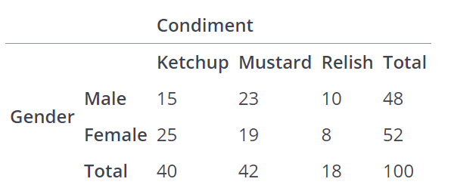
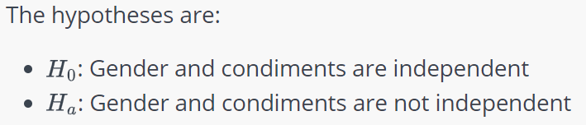
Example 3: A food services manager for a baseball park wants to know if there is a relationship between gender (male or female) and the preferred condiment on a hot dog. The following table summarizes the results. Test the hypothesis with a significance level of 10%.

Slide 36
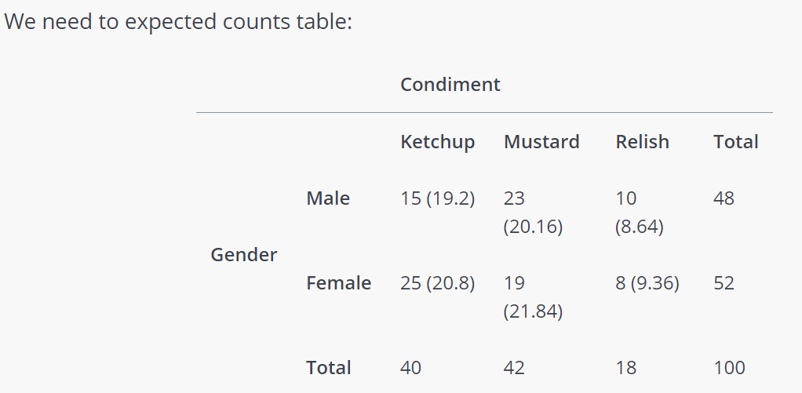
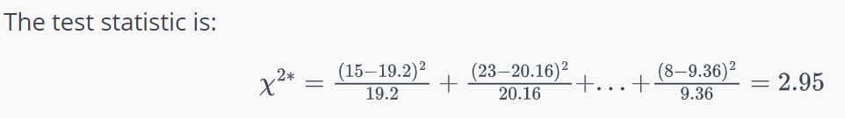
Degrees for freedom equal to (2−1)(3−1)=2.
At 10% level of significance and degree of freedom = 2, the critical value of chi-square = 7.779
Since the calculated chi-square value is smaller than the critical chi-square value, we accept the null hypothesis that the gender and the condiment are independent.

Slide 37
Posterior Predictive Model Checking
Posterior Predictive Model Checking is a Bayesian method for assessing how well a statistical model fits observed data by comparing the observed data to simulated data generated from the model.
This approach helps identify systematic differences between the model and the data.
The posterior predictive distribution represents our predictions for new, unobserved data points based on:
The fitted model
The observed data
The uncertainty in our parameter estimates
Mathematically, it's expressed as: p(y_new | y) = ∫ p(y_new | θ) p(θ | y) dθ
Where:
y_new is new, unobserved data
y is observed data
θ represents model parameters
p(θ | y) is the posterior distribution
p(y_new | θ) is the likelihood for new data

Slide 38
Posterior Predictive Model Checking (PPMC) Process
Fit the Model: Obtain the posterior distribution of parameters using MCMC or other methods
Generate Replicate Datasets: Draw samples from the posterior predictive distribution
Choose Test Statistics: Select summary statistics or test quantities
Compare: Evaluate discrepancies between observed and simulated data
Assess: Calculate posterior predictive p-values or visual comparisons

Slide 39
Posterior Predictive P-values
Values close to 0.5 suggest good fit
Values close to 0 or 1 suggest poor fit
Not directly comparable to classical p-values

Slide 40
Common Test Statistics for PPMC
Summary Statistics
Mean
Variance
Quantiles
Skewness
Kurtosis
Domain-Specific Metrics
Residual patterns
Correlation structures
Extreme value behavior

Slide 41
Advantages and Limitations of PPMC
Advantages
Incorporates parameter uncertainty
Flexible choice of test quantities
Visual and numerical assessments
Works with complex models
Limitations
Choice of test statistics can be subjective
Computational intensity for complex models
May not detect all types of model misfit
P-values should not be over-interpreted

